Slide 1

James Cadek
Zachary Lubinski
James Moore
Kyle Ross
Tanvir Sajed
Jeremy Smereka
Scott Vig

Slide 2
Product Overview
AntiC provides easy access for non-oncology pharmacists to browse important information regarding oral chemotherapeutics.
The AntiC project is separated into 3 distinct areas:
Mobile device application
Website
Server
The server hosts the pertinent medical information and provides an API for the website and mobile app to communicate and download the information.
The mobile app and website display the information in a friendly manner to the health care professional.
The website contains an admin console which can be used to add, delete, or update information regarding oral chemotherapeutics.

Slide 3
Chosen Architecture - Website
Our website is built on the Silex PHP microframework.
HTML5 and Javascript are used in conjunction with Bootstrap, JQuery and AngularJS.
Twig was used for HTML templating.
Composer was used to amalgamate libraries.

Slide 4
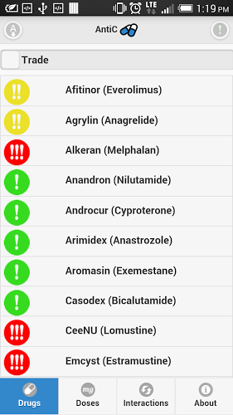
Chosen Architecture - Mobile
The AntiC mobile app was developed using PhoneGap 2.3.0 on the Android platform, and was later ported to iOS.
The app uses jQuery Mobile Framework as a user interface system for creating buttons, list elements, and styles.
The connection with the remote server is done via jQuery. Ajax is called to download the medical information and images.
For information storage, the app uses the FileStorage API from PhoneGap to save the medical data and images on the permanent storage of the phone, allowing for offline usage.

Slide 5
Chosen Architecture - Server
The Server is built on an Amazon EC2 instance with Ubuntu.
We used MySQL for the database host.
The API is set up to accept PUT, GET, POST, and DELETE requests and uses basic json objects for data transfer.

Slide 6
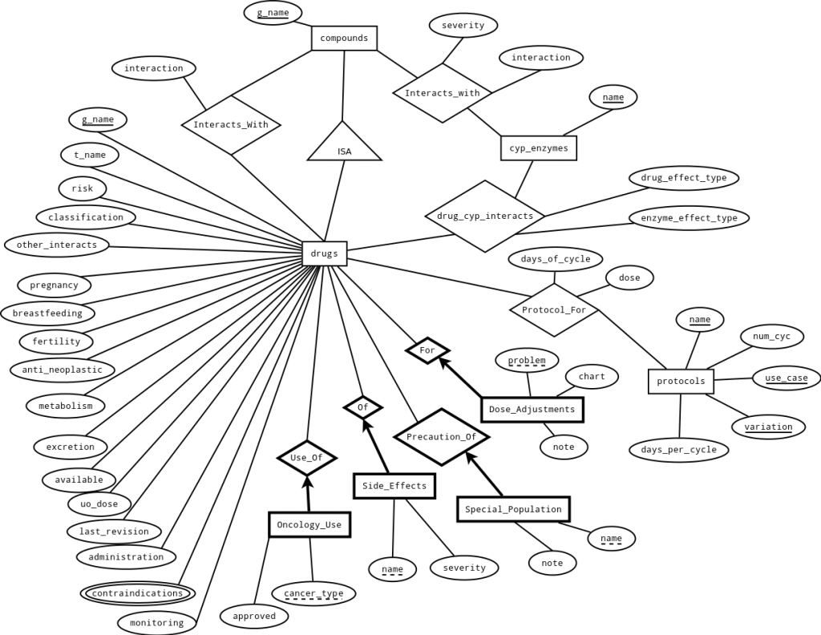
Database ER Diagram

Slide 7
Implementation Challenges - Mobile
Dealing with differing opinions on stylistic choices kept us on our toes. For example, the risk icons were changed several times before all of the TAs and our client were satisfied.
Optimization for the mobile app was often centred around finding subtle performance issues with jQuery and PhoneGap.
Making sure features added to mobile application were supported by multiple platforms (Android and iOS).
Lack of test data for front end of mobile application. This occurred because back end of project took longer to complete than the front end.

Slide 8
Implementation Challenges - Website
Using an external library for the system proved challenging due to most of the functionality needing to be heavily modified.
It was challenging to provide a useful template for entering the incoming data.
The POST api proved difficult.

Slide 9
Implementation Challenges - Server
The medical data didn’t follow a consistent format. This made parsing the existing data impossible to completely automate.
This made creating a database structure difficult as well, as it was difficult to define a structure.

Slide 10
Management Challenges
Managing differences in requirements between professor, teaching assistants, and client.
Burndown chart plugin didn’t function properly.
Adapting to changing requirements:
Removal of protocols section
Removal of options page
Changing the whole appearance of the website
Waiting for information on requirements from pharmacists.

Slide 11
Lessons Learned
Project stakeholders aren’t as interested in the back-end functionality of a project as compared to the front-end appearance. All they want is for the project to work fast and look pretty.
Often it’s best to wait to develop front-end interfaces until after the back-end functionality is complete, since back-end structures may change suddenly.
Burndown charts are a valuable form of time management feedback.

Slide 12
Questions?

